Slide 1
Global Health @ PGME

Slide 2
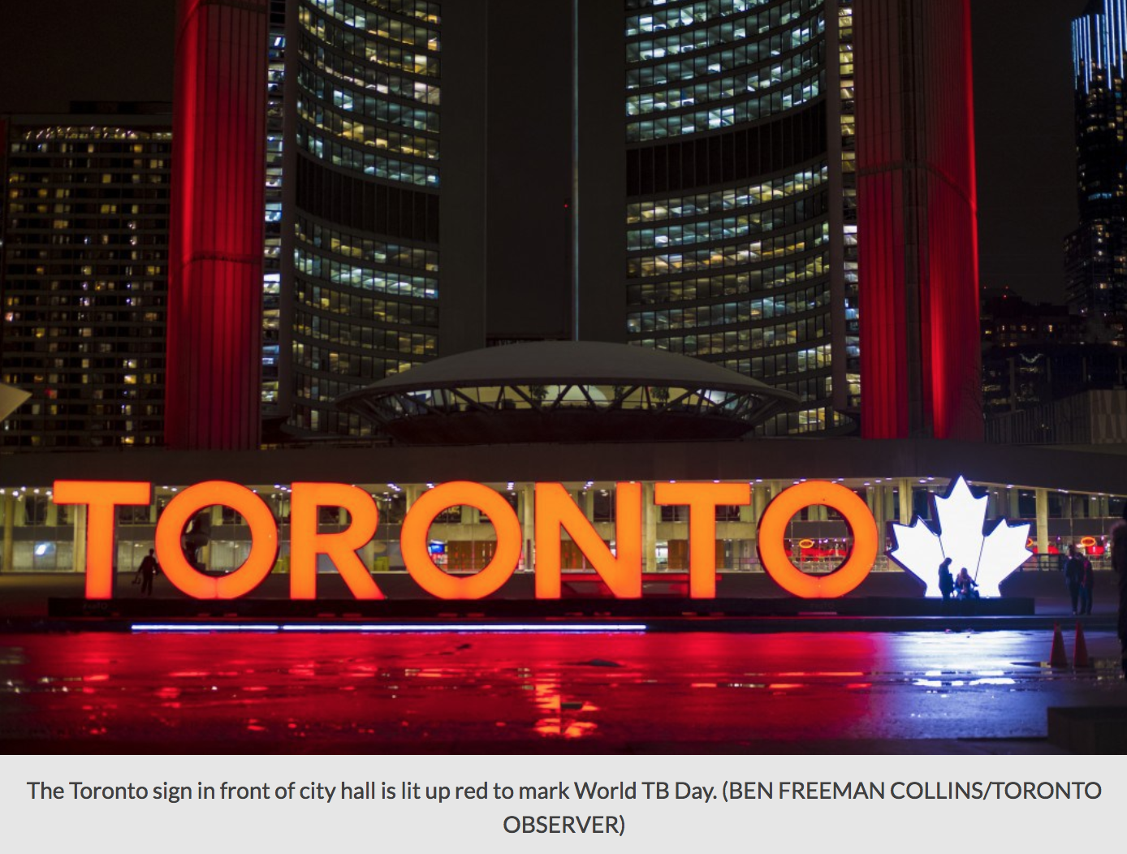

Slide 3
http://gh.postmd.utoronto.ca/

Slide 4
Ongoing Activities
Global Health Education Initiative
2 year interspecialty co-curricular program
~40 new registrants annually (~100 in both yrs)
~100 faculty
~200 graduates since 2009
New Module and New Theme
New Module - Transition to Global Health Practice
New Theme – Geriatric populations - included as part of Special Populations Module

Slide 5
Ongoing Activities
GH Electives Process and Support
Guidelines, registration, PDT, PRD, Evaluation, GH ITER
Award adjudication - Social Resp; Sheppard
Journal Clubs
GH Education Sub-committee
GH Website

Slide 6
PGME GH Events
GHEI Alumni Events
GH Governance (Jerome Singh); Peter Donnelly (Violence PH Issue)
GH Resident Research Showcase – Feb 1, 2018
GH Day ‘Activism’ – May 31st, 2018
Monthly blogs

Slide 7
Your Role…
Events
GH Day – May 31, 2018 (May 30, 2019) -Encourage and support participation.
GH Resident Research Showcase (Jan 31, 2019) - Encourage and support participation.
GH Journal Clubs - Encourage and support participation.
Awards - Encourage awareness and support nominations of

Slide 8
Your Role?
Global Health Education Initiative (GHEI)
Encourage interested residents to apply
Support residents to participate (& let us know if problems)
GH Electives
Ensure residents are aware and complete process.
Recognize and support GH electives
Website - http://gh.postmd.utoronto.ca/
Review – suggest GH faculty & trainee /content
Assign/augment GH Leads

Slide 9
Thank you!
Judy Kopelow BA RN MEd Manager, Global Health Programming and Strategic Initiatives Administrative Director, Global Health Education Initiative Postgraduate Medical Education
j.kopelow@utoronto.ca

Slide 10
Consult Global Health Experience Guidelines
GHE Application
Dept GH Lead
PGME GH Lead
GHE Committee
Post-Travel Debriefing
Pre-departure Training and Preparation
Registration and Logistics
Ethics
Educational Integrity and Supervision
Health and Safety
Predeparture Training & Post-Travel Debriefing
WHY?
Trainee considering Global Health Experience
1. Date/Location/Contact info 2. Context (facility, organization, population)
3. Activities/Roles 4. Toronto and Field supervision
5. CANMEDs Objectives 6. Permissions (PD, REB, CMPA, Lic.)
Travel and medical practice safety.
Basic Global Health knowledge and skills & Global health ethics.
Specialty specific training
Level of training specific guidance
Mission/Activity specific orientation
?
Discussion with faculty, global health lead, program director, PGME GH Lead
Educational infrastructure, health care and systems, resources, local epidemiology, culture
Personal and Operational
Home and Field
Assessment and Evaluation

